Slide 1
Artificial Intelligence
Adversarial Search Algorithms
Notes:
Slides and exercises are inspired by Russell & Norvig AI Book, Stanford’s AI course and from Berkeley’s AI course

Slide 2
Adversarial search
Search problem :
S0: The initial state
PLAYER(s): Defines which player has the move in a state.
ACTIONS(s): Returns the set of legal moves in a state.
RESULT(s, a): The transition model, which defines the result of a move.
TERMINAL-TEST (s): A terminal test, which is true when the game is over and false otherwise. States where the game has ended are called terminal states.
UTILITY(s, p): A utility function (also called an objective function or payoff function),
UTILITY(s, p) defines the final numeric value for a game that ends in terminal state s for a player p.

Slide 3
Zero sum games
In chess, the outcome is a win, loss, or draw, with values +1, 0 or 1/2.
Some games have a wider variety of possible outcomes; the payoffs in backgammon range from 0 to +192.
A zero-sum game is (confusingly) defined as one where the total payoff to all players is the same for every instance of the game.
Chess is zero-sum because every game has payoff of either 0+1, 1+0 or 1/2+1/2
“Constant-sum” would have been a better term …

Slide 4
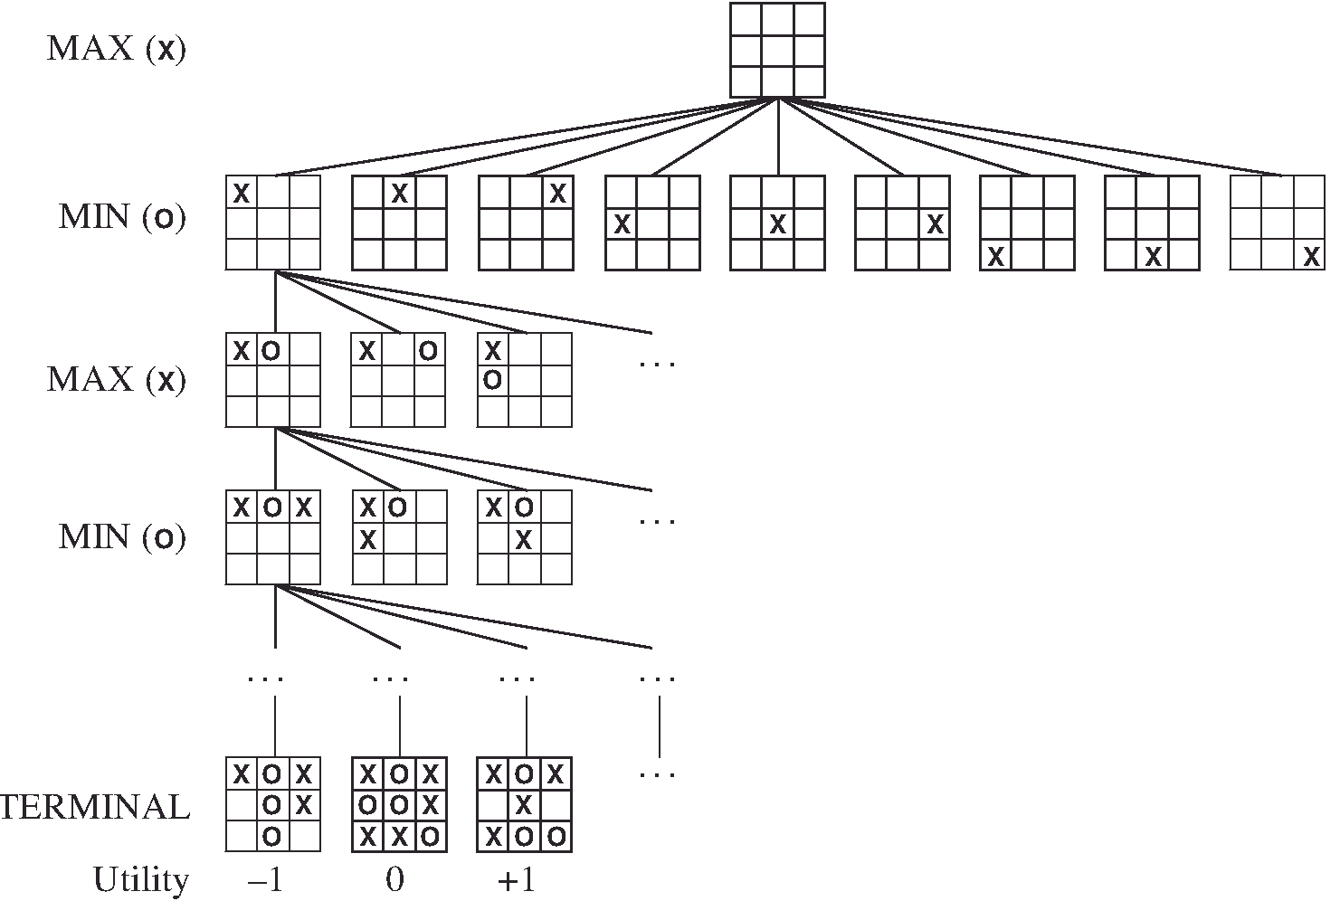
Game tree (tic-tac-toe)

Slide 5
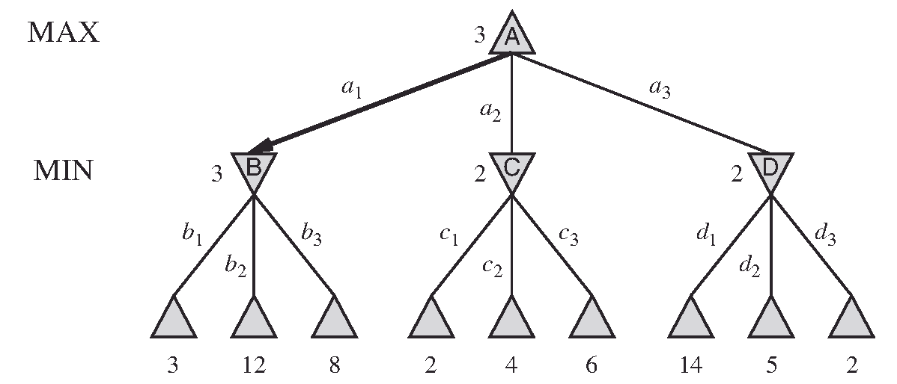
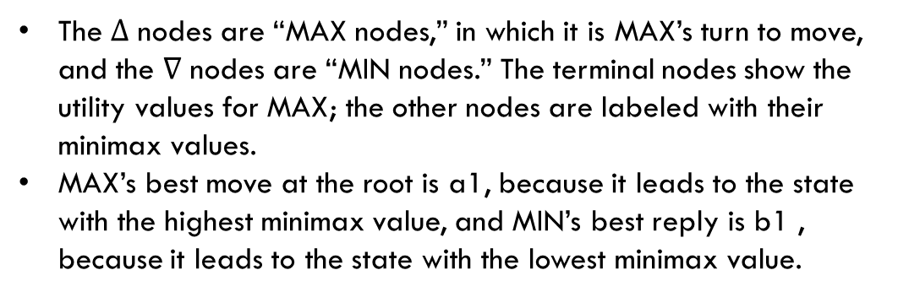
A too ply game tree
The $∆$ nodes are “MAX nodes,” in which it is MAX’s turn to move, and the $∇$ nodes are “MIN nodes.” The terminal nodes show the utility values for MAX; the other nodes are labeled with their minimax values.
MAX’s best move at the root is a1, because it leads to the state with the highest minimax value, and MIN’s best reply is b1 , because it leads to the state with the lowest minimax value.
Notes:
In game parlance, we say that this tree is one move deep, consisting of two half-moves, each of which
is called a ply.

Slide 6
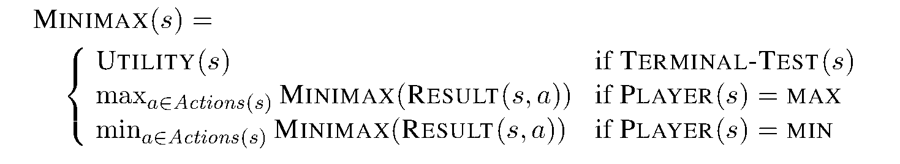
Minimax recursive function
Q: What if Min does not play optimally?
A: Max will do even better

Slide 7
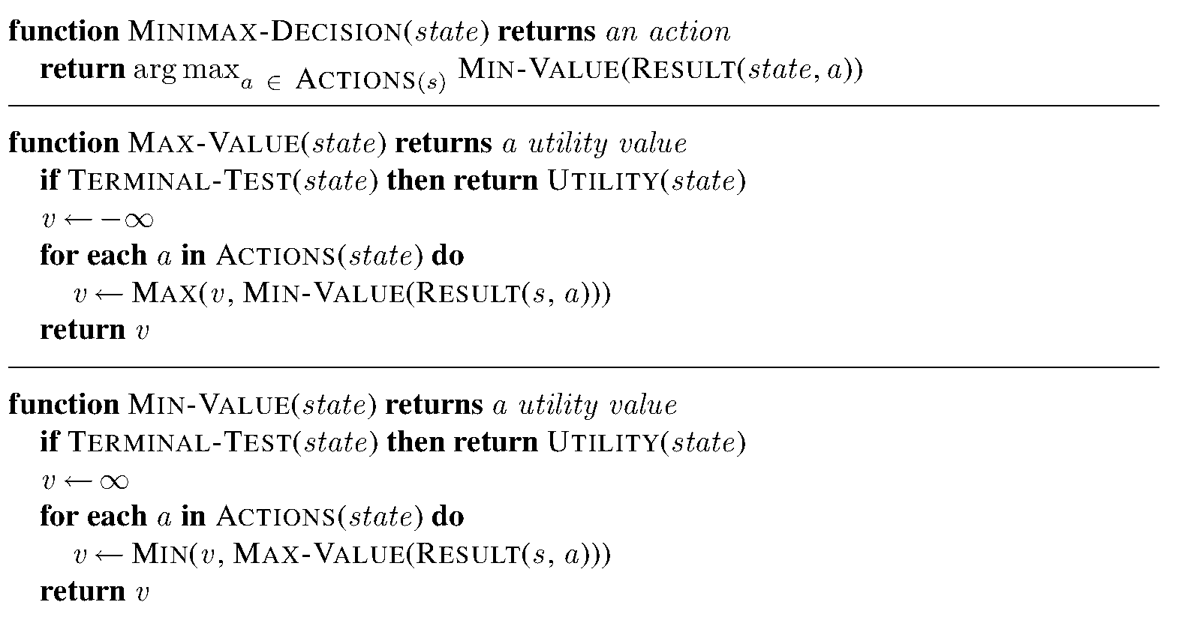
Minimax algorithm

Slide 8
Complexity
Depth: m
Number of legal moves: b
O(bm) space
O(b^{m}) time
Example: for chess, b=35, m=100 (50 for each player)
It means that full search is not practical:
Suppose we have 100 seconds per move, can explore 10K nodes / sec
So can check 1M nodes per move (depth 4)
With pruning we can reach about depth 8 in chess

Slide 9
Multi-player games
Utility (s) returns a vector (utility for each player)
Usually, alliances are formed and broken as game proceeds

Slide 10
Alpha-beta pruning
z
x
y
MINIMAX(root ) = max(min(3, 12 , 8), min(2,x,y), min(14, 5, 2))
=max(3, min(2,x,y), 2)
=max(3,z,2) where z =min(2,x,y) ≤ 2
=3
We can prune the nodes x and y without any impact on the result!

Slide 11
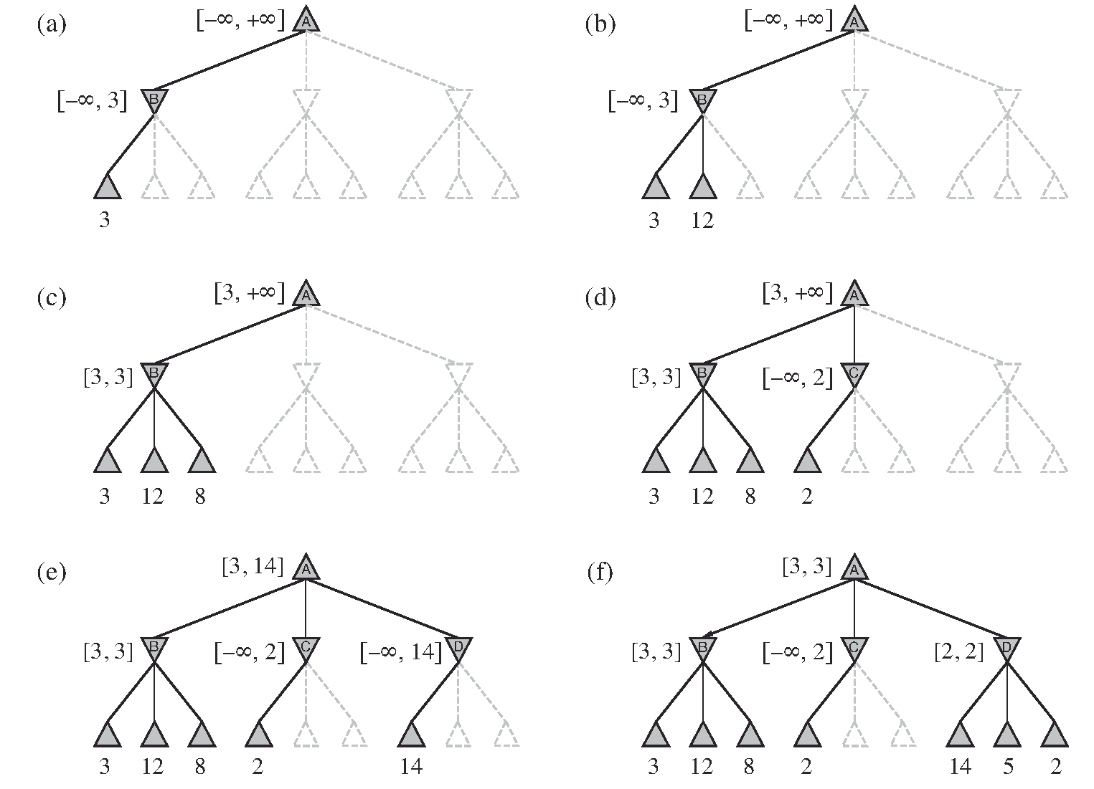
Alpha-beta pruning
Range of possible values for this node

Slide 12
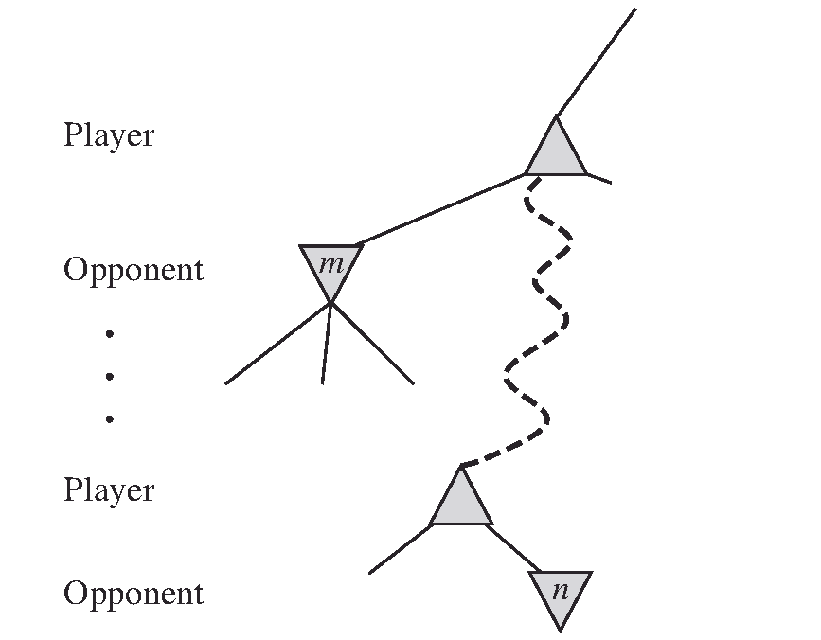
Alpha-beta pruning, the general case
α = the value of the best (i.e ., highest-value) choice we have found so far at any choice point along the path for MAX.
β = the value of the best (i.e ., lowest-value) choice we have found so far at any choice point along the path for MIN.
If m is better than n for Player, we will never get to n in play.
So once we have found out enough about n (by examining some of its descendants) to reach this conclusion, we can prune it.
Notes:
α: MAX’s best option on path to root
β: MIN’s best option on path to root

Slide 13
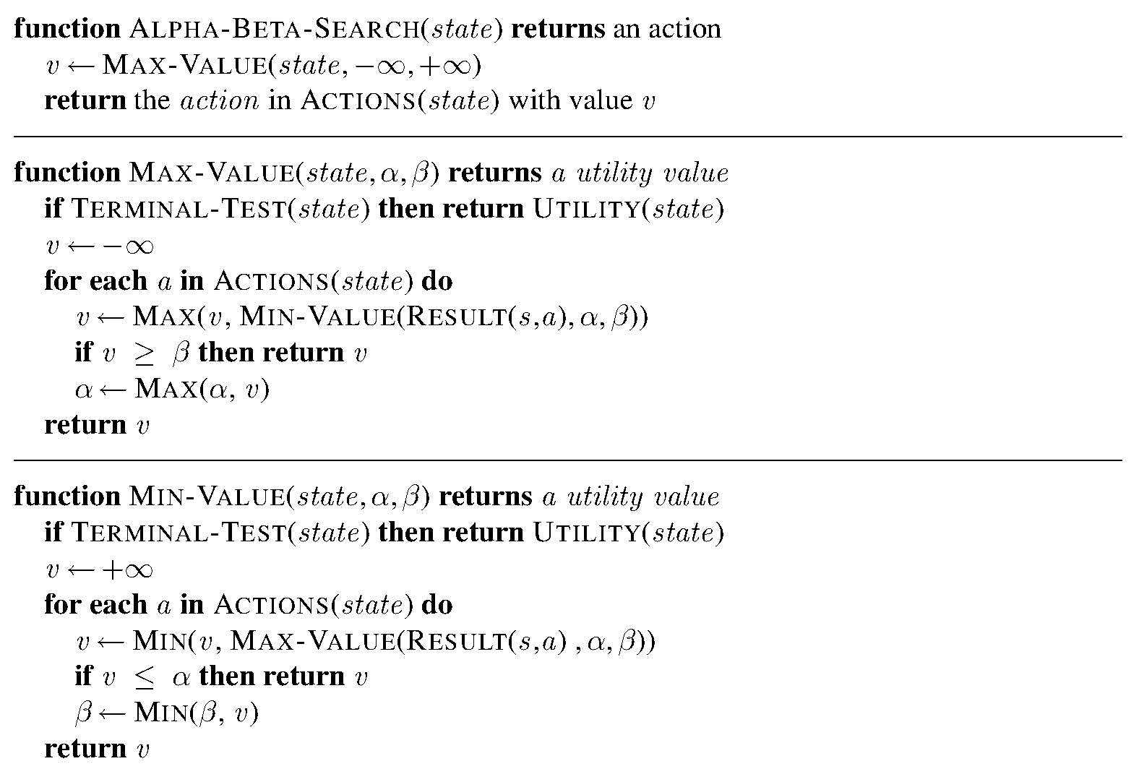
Alpha – beta pruning algorithm

Slide 14
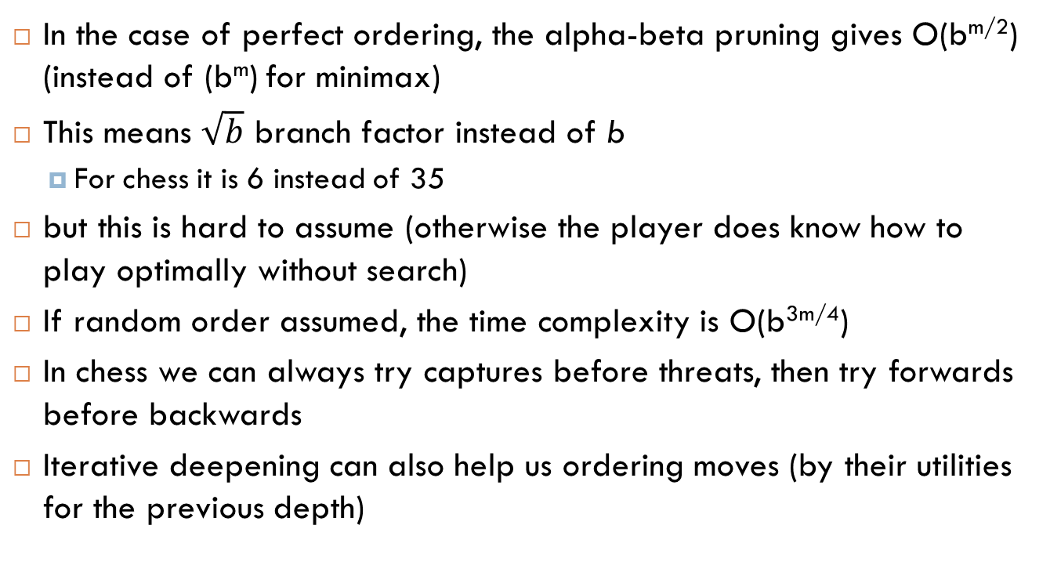
Move ordering
In the case of perfect ordering, the alpha-beta pruning gives O(b^{m/2}) (instead of (b^{m}) for minimax)
This means $\sqrt{b}$ branch factor instead of b
For chess it is 6 instead of 35
but this is hard to assume (otherwise the player does know how to play optimally without search)
If random order assumed, the time complexity is O(b^{3m/4})
In chess we can always try captures before threats, then try forwards before backwards
Iterative deepening can also help us ordering moves (by their utilities for the previous depth)

Slide 15
Techniques to play better
Dynamic move ordering
Killer moves (human experience)
Transposition tables (a hash table which stores repeated states and their utilities /minimax values)

Slide 16
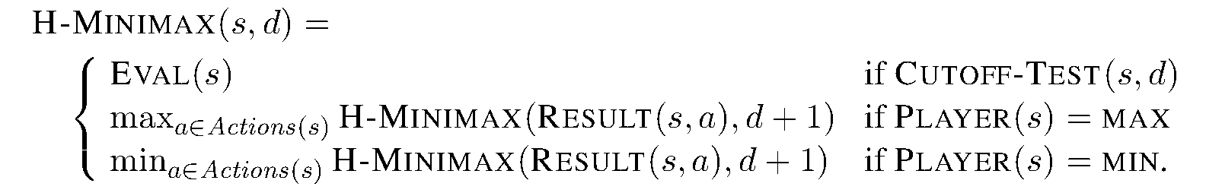
Heuristic minimax

Slide 17
What is a good evaluation function (eval)
For terminal states, the order of the states given by the function is the same as the order given by the true utility
Computation efficiency (doesn’t take too long to compute)
For non-terminal nodes, the evaluation is correlated with the actual chances of win

Slide 18
Evaluation function example
2 pawns against 1 pawn game (chess)
Our experience suggests that :
This is a win (+1) for 72% of states
This is a loss (0) for 20% of states
This is a draw (1/2) for 8% of states
Expected value = 0.72*1+0.2*0+0.08*0.5=0.76

Slide 19
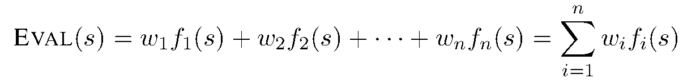
Weighted linear function
Example of features: material value of pieces (chess)
Pawn: 1
Bishop/ knight: 3
Rook: 5
Queen: 9
Good pawn structure: ½
King safety: ½
Move number
Number of remaining pieces
Example of weights: The number of pieces of each kind
Non-linear combinations are sometimes better:
For example two bishops can be evaluated as slightly better than 6 (3+3)
They are also worth more at the end of the game
End of game features

Slide 20
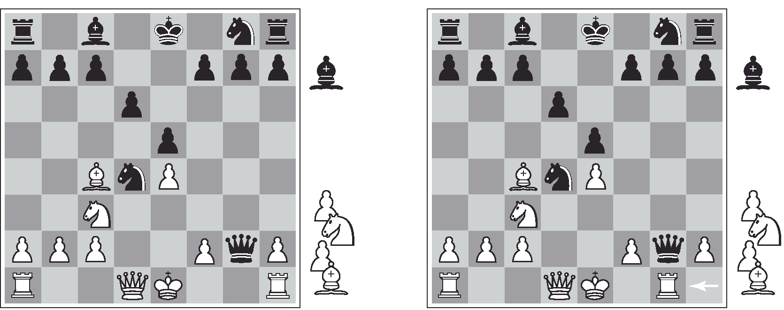
When to cut-off search ?
Are we in a quiescent state, or things will change dramatically in the next few moves?
Notes:
White to move in both sides

Slide 21
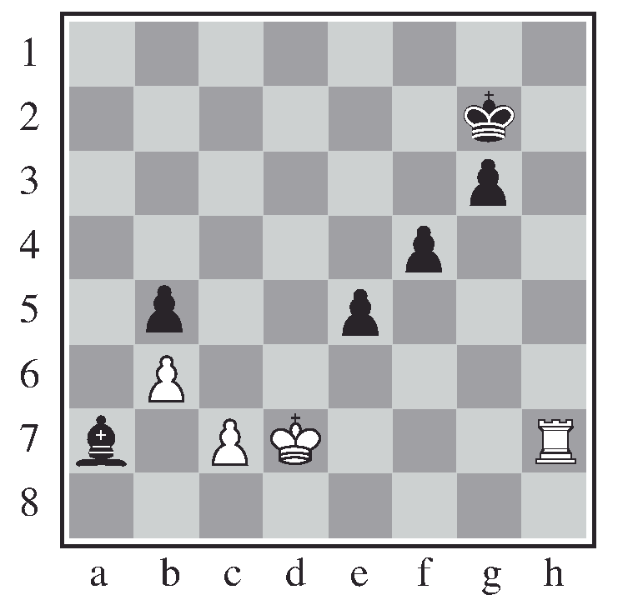
The horizon effect
things are unavoidable but it seems that scarifying some pieces help avoiding them because of the horizon effect.
With Black to move, the black bishop is surely doomed.
But Black can forestall that event by checking the white king with its pawns, forcing the king to capture the pawns. This pushes the inevitable loss of the bishop over the horizon, and thus the pawn sacrifices are seen by the search algorithm as good moves rather than bad ones.

Slide 22
Forward pruning
Beam search: Consider a beam of the n-best moves (according to the evaluation function) and explore them
ProbCut: prune nodes that are probably out of the alpha-beta window
In chess programming, we do
Lookup for the openings (well-known moves, expertise of humans)
Search for the majority of the game
Follow policies at the ends of games (when less than 6 pieces are left)
Policies are previously obtained by retrograde minimax search
For example for the end KBNK (King, Bishop, Knight vs. King) there are 3,494,568 possible states
Start by states that are checkmates
Do retrograde search until all possible states are decided as win, draw or loss
Now you have an infallible lookup table for KBNK games

Slide 23
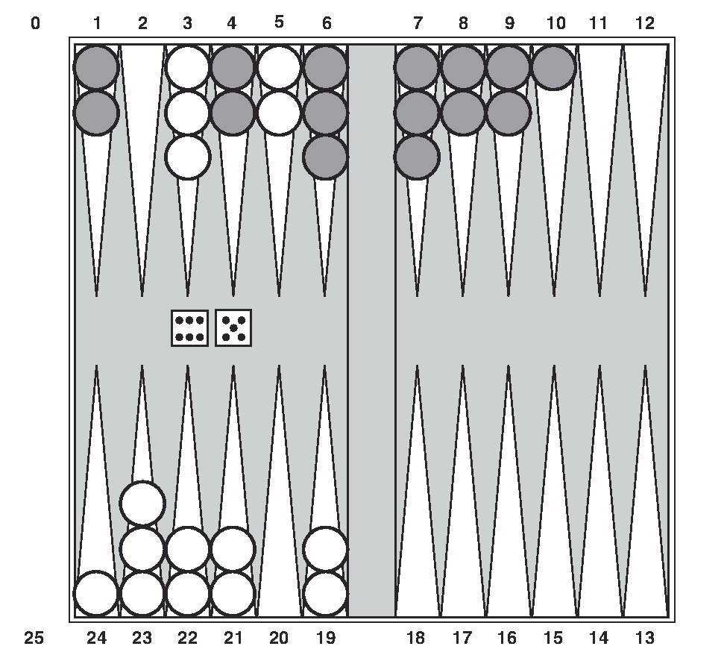
Stochastic games
The goal of the backgammon game is to move all one’s pieces off the board. White moves clockwise toward 25, and Black moves counterclockwise toward 0.
A piece can move to any position unless multiple opponent pieces are there; if there is one opponent, it is captured and must start over.
In the position shown, White has rolled 6–5 and must choose among four legal moves: (5–10,5–11), (5–11,19–24), (5–10,10–16), and (5–11,11–16),
where the notation (5–11,11–16) means move one piece from position 5 to 11, and then move a piece from 11 to 16.

Slide 24
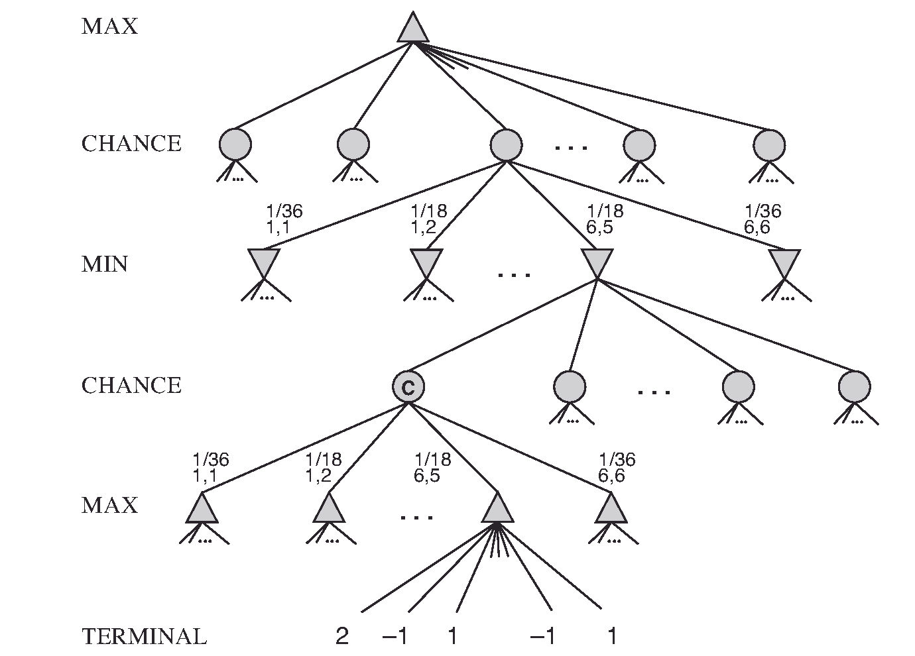
Chance nodes
21 distinct rolls:
6 rolls having probability 1/36
15 rolls having probability 1/18
We calculate the expected value of a position: the average over all possible outcomes of the chance nodes.
Notes:
We reflect average-case (expectimax) outcomes, not worst-case (minimax) outcomes
Note that in the figure above Max plays then Min rolls a dice then Min plays …

Slide 25
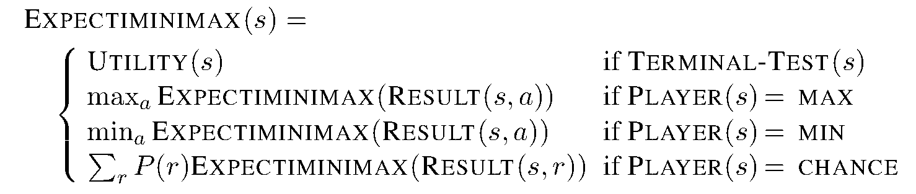
Expectiminmax algorithm
r is the result of the dice roll
Complexity: O(b^{m} n^{m})
Where n is the number of distinct rolls.

Slide 26
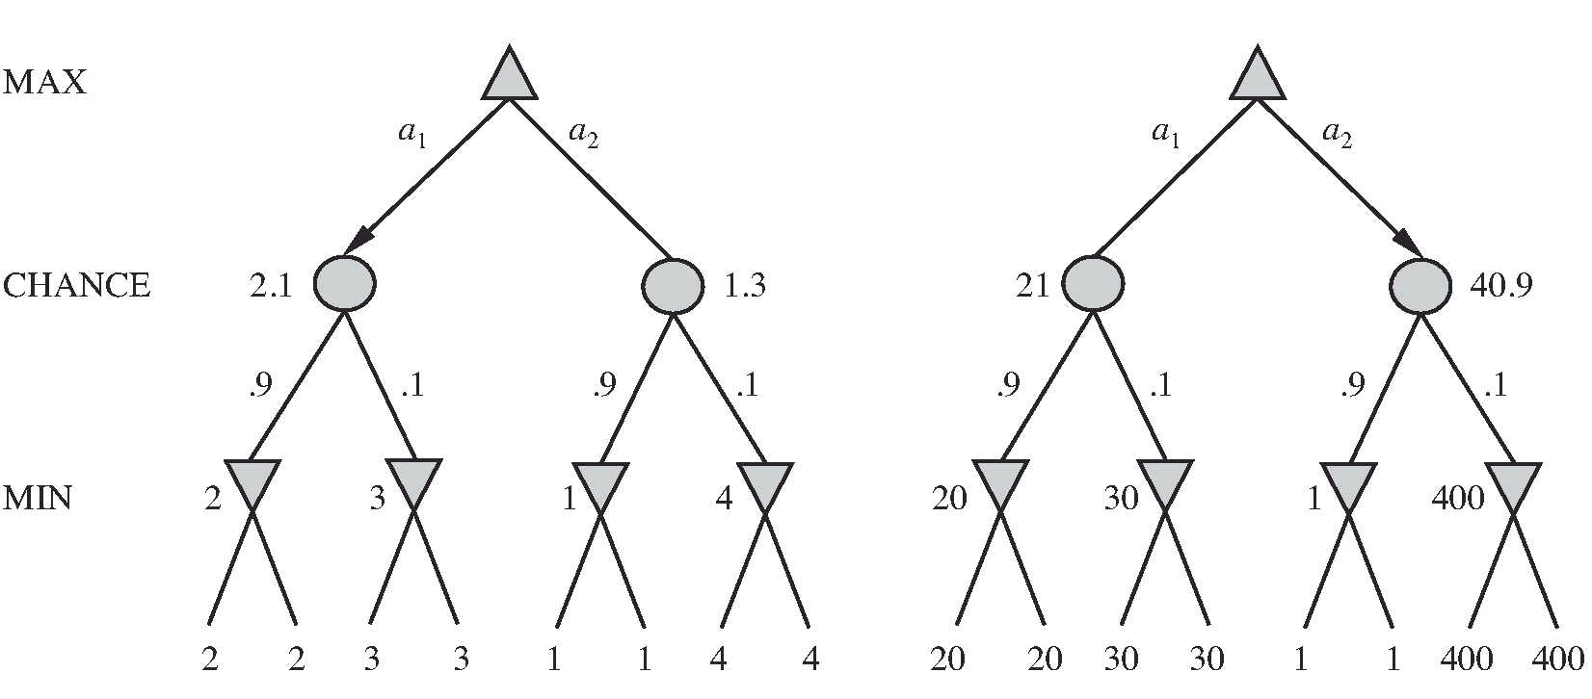
Evaluation function for expectiminimax
It is not sufficient that the evaluation function preserves the good orders
the evaluation function must be a positive linear transformation of the probability of winning from a position (or, more generally, of the expected utility of the position).
Notes:
A positive linear transformation of a variable, say X, consists of multiplying X by a positive constant b and adding a constant a to the product: X’=a+bX

Slide 27
Optimization
Q: Is alpha-beta pruning possible for stochastic games?
A: yes, if all utility values are bounded, we can put an upper bound/lower bound on the expected value of a chance node.
Example:
utility is between 2 and -2
A chance node has two children with equal probabilities
The first child is +1
The upper bound for the average is (1+2)/2 ; the minimum bound is (1-2)/2 (without looking at the second child)
We can use Monte Carlo simulation to evaluate a position. Start with an alpha–beta (or other) search algorithm. From a start position, have the algorithm play thousands of games against itself, using random dice rolls.
In the case of backgammon, the resulting win percentage has been shown to be a good approximation of the value of the position, even if the algorithm has an imperfect heuristic and is searching only a few plies
For games with dice, this type of simulation is called a rollout.

Slide 28
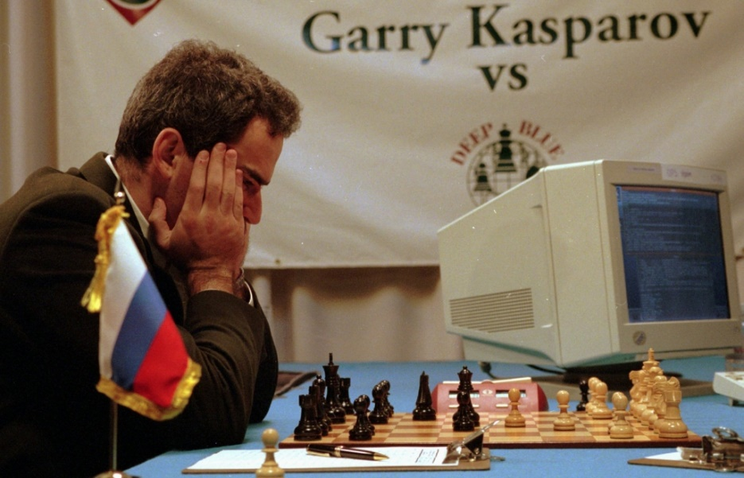
Do computers play better than humans?
Programs have bested even champion human players at games such as chess, checkers, Othello, Go, and Poker.
Human retain the edge in a few games of imperfect information such as bridge and Kriegspiel.
In video games such as StarCraft and Dota 2, programs are competitive with human experts, but part of their success may be due to their ability to perform many actions very quickly.
Kasparov vs. Deep Blue

Slide 29

More about utilities
Utilities are functions from outcomes (states of the world) to real numbers that describe an agent’s preferences
An agent must have preferences among:
Prizes: A, B, etc.
Lotteries: situations with uncertain prizes: L=[p, A; (1-p), B]
Preference: $A≻B$
Indifference: $A∼B$

Slide 30
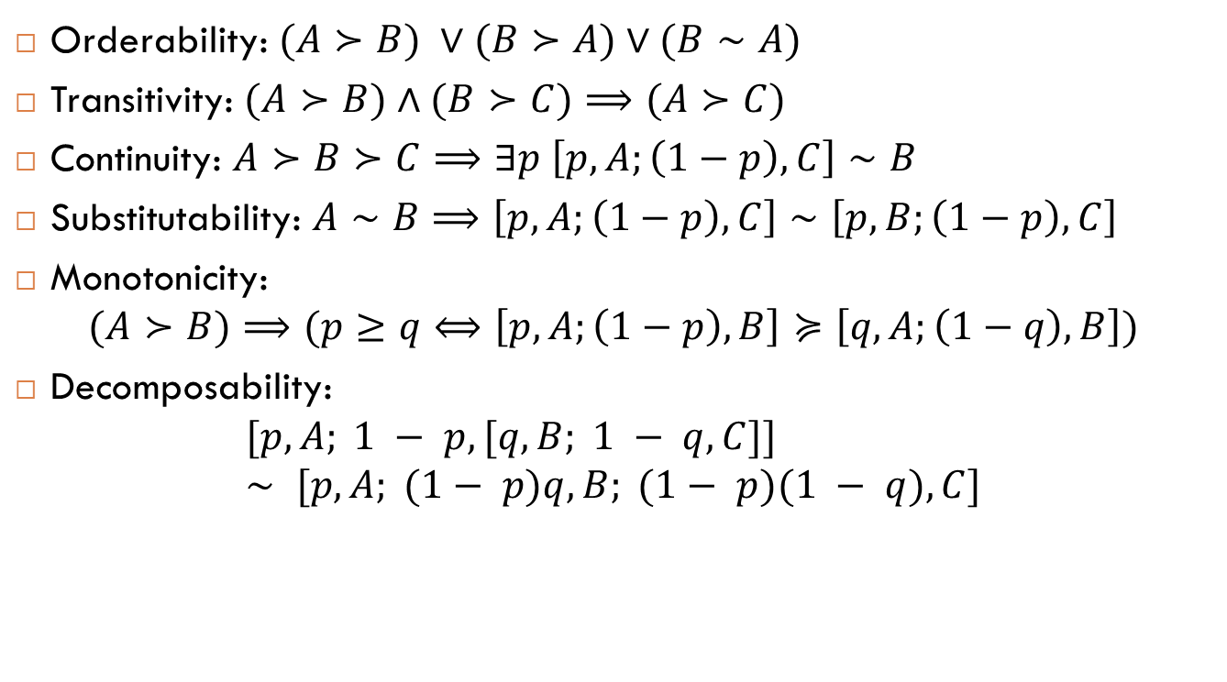
Rational preferences
Orderability: $(A≻B) ∨(B≻A)∨(B∼A)$
Transitivity: $(A≻B)∧(B≻C)⟹(A≻C)$
Continuity: $A≻B≻C⟹∃p \left[p,A;\left(1−p\right),C\right]∼B$
Substitutability: $A∼B⟹\left[p,A;\left(1−p\right),C\right]∼\left[p,B;\left(1−p\right),C\right]$
Monotonicity:
$$(A≻B)⟹(p≥q⟺\left[p,A;\left(1−p\right),B\right]≽\left[q,A;\left(1−q\right),B\right])$$
Decomposability:
$$[p,A; 1 − p, [q,B; 1 − q,C]] ∼ [p,A; (1− p)q,B; (1− p)(1 − q),C]$$

Slide 31
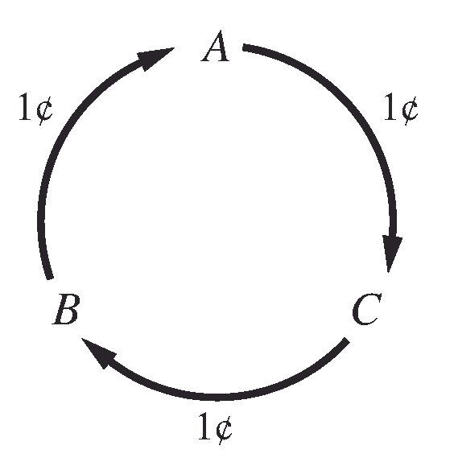
Why these axioms?
You can push an agent to behave irrationally if he does not respect these axioms
For example you can make an agent loses all his money if he does not respect transitivity

Slide 32

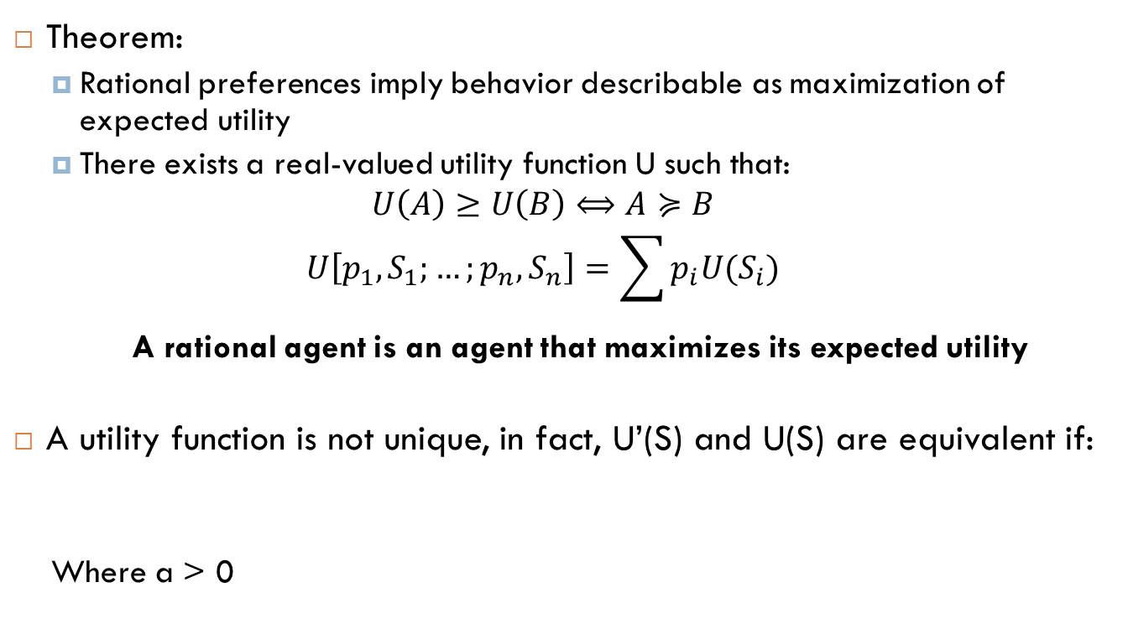
Rational preferences
Theorem:
Rational preferences imply behavior describable as maximization of expected utility
There exists a real-valued utility function U such that:
$$U\left(A\right)≥U\left(B\right)⟺A≽B$$
$$U\left[p_{1},S_{1};…;p_{n},S_{n}\right]=\sum{p_{i}{U(S}_{i})}$$
A rational agent is an agent that maximizes its expected utility
A utility function is not unique, in fact, U’(S) and U(S) are equivalent if:
Where a > 0
Notes:
⊥ - up tack

Slide 33
How to build a utility function?
Given a utility scale between u_{T} and u⊥, we can assess the utility of any particular prize S by asking the agent to choose between S and a standard lottery [p, u_{T} ; (1−p), u⊥]
The probability p is adjusted until the agent is indifferent between S and the standard lottery.
Assuming normalized utilities (u_{T}=1, u⊥=0) the utility of S is given by p. Once this is done for each prize, the utilities for all lotteries involving those prizes are determined.
Notes:
Inverted T symbol is called up-tack ( \bot in Latex)

Slide 34
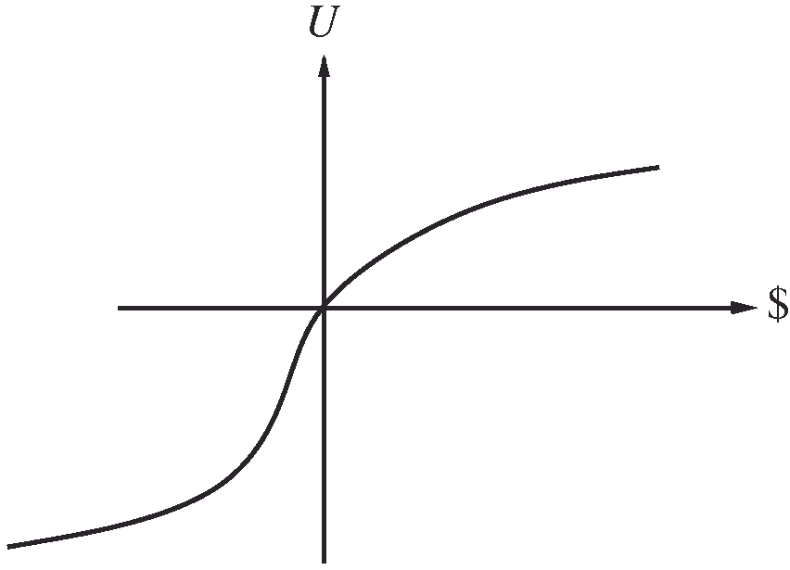
Example: Utility of money
Either you can take the $1,000,000 prize or you can gamble it on the flip of a coin. If the coin comes up heads, you end up with nothing, but if it comes up tails, you get $2,500,000. What do you prefer?
Example:
U(k+2,500,000)=9
U(k+1,000,000)=8
U(k)=5
What is its expected monetary value?
What is its expected utility value?

Slide 35
Example: insurance
Consider the lottery [0.5, $1000; 0.5, $0]
What is its expected monetary value?
$500
What is its certainty equivalent? Monetary value acceptable in lieu of lottery
$400 for most people (risk-averse)
The difference between the EMV of a lottery and its certainty equivalent is called the insurance premium
It’s win-win: you’d rather have the $400 and the insurance company would rather have the lottery (risk-neutral)
Notes:
When deeply in debt your behavior could be risk-seeking

Slide 36
Are humans rational?
Allais paradox
A or B ?
A : 80% chance of $4000
B : 100% chance of $3000
C or D?
C : 20% chance of $4000
D : 25% chance of $3000
Notes:
Most people prefer B over A (certainty effect) and C over D

Slide 37
Ellsberg paradox
Your payoff will depend on the color of a ball chosen from an urn.
You are told that the urn contains 1/3 red balls, and 2/3 either black or yellow balls, but you don’t know how many black and how many yellow. Again, you are asked whether you prefer lottery:
A or B;
A : $100 for a red ball
B : $100 for a black ball
and then C or D:
C: $100 for a red or yellow ball
D : $100 for a black or yellow ball
Notes:
Most people prefer A over B
Most people prefer D over C. The reason is ambiguity aversion
But let’s see if we have more yellow than black => A > B and C > D
If we have more black than yellow => B > A and D> C !!

Slide 38
Human judgement
Certainty effect (“a bird in the hand is worth two in the bush”)
Ambiguity aversion
Regret
Framing effect:
Experiments show that people like a medical procedure that it is described as having a “90% survival rate” about twice as much as one described as having a “10% death rate”
Anchoring effect
People feel more comfortable making relative utility judgments rather than absolute ones. A restaurant takes advantage of this by offering a $200 bottle that it knows nobody will buy, but which serves to skew upward the customer’s estimate of the value of all wines and make the $55 bottle seem like a bargain

Slide 39
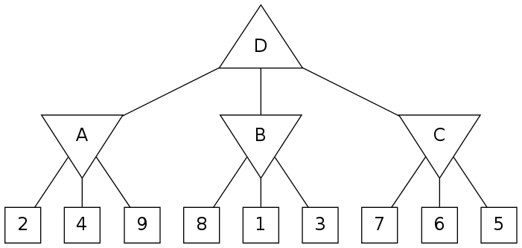
Exercise 1
Consider the zero-sum game tree shown below. Outcome values for the maximizing player are listed for each leaf node, represented by the values in squares at the bottom of the tree. Assuming both players act optimally, carry out the minimax search algorithm.
Notes:
A: 2
B: 1
C: 5
D: 5

Slide 40
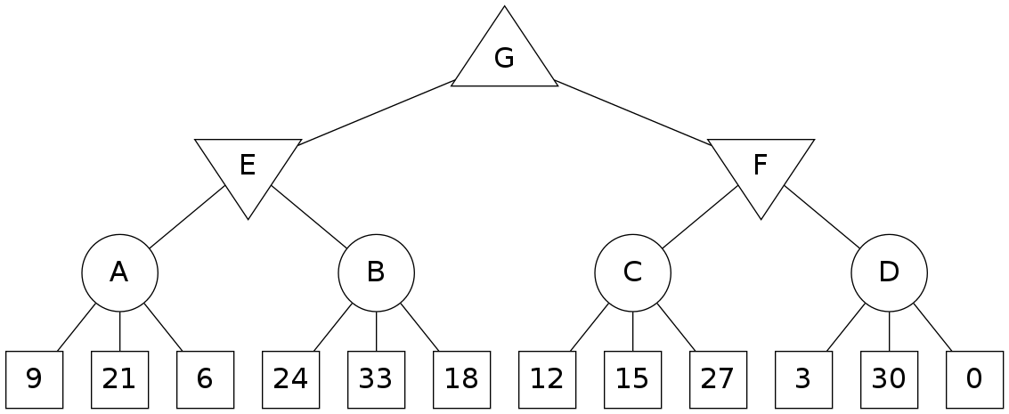
Ex 2
The circular nodes represent chance nodes in which each of the possible actions may be taken with equal probability. The square nodes at the bottom represent leaf nodes. Assuming both players act optimally, carry out the expectiminimax search algorithm.
Notes:
A: 12
B: 25
C: 18
D: 11
E: 12
F: 11
G: 12

Slide 41
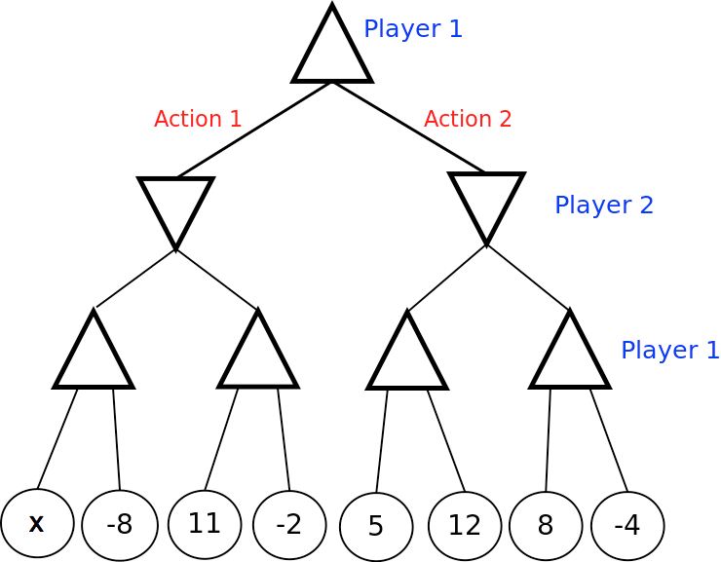
Ex 3
Assume Player 2 is a minimizing agent (and Player 1 knows this). For what values of x is Player1 guaranteed to choose Action 1?
Assume Player 2 chooses actions at random with each action having equal probability (and Player 1 knows this). For what values of x is Player 1 guaranteed to choose Action 1?
Notes:
x>8
x>9

Slide 42
Ex 3
Denote the minimax value of the tree as the value of the root when Player 1 is the maximizer and Player 2 is the minimizer. Denote the expectimax value of the tree as the value of the root when Player 1 is the maximizer and Player 2 chooses actions at random (with equal probability). For what values of x is the minimax value of the tree worth more than the expectimax value of the tree?
Notes:
Minimax = Max(Min(Max(x,-8), 11) , 8)
Expectimax = max( 0.5 * max(x,-8) +0.5 *11 , 10)
Minimax > expectimax => min(max(x,-8), 11 ) > 10 and min(max(x,-8) , 11) > 0.5 *max(x,-8) +5.5
If -8<x<11 => (x> 10 and x> 0.5*x+5.5) => x >11 contradiction, …
If x>11 => 11> 0.5*x+5.5 > 11 impossible ..
The only possible case is x=11 where minimax = expectimax but it is impossible to have minimax > expectimax

Slide 43
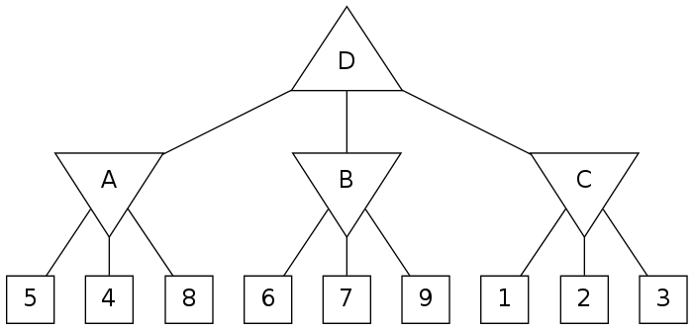
Ex4: alpha-beta pruning
Assuming both players act optimally, use alpha-beta pruning to find the value of the root node. The search goes from left to right. Which leaf nodes do not get visited due to pruning?
Notes:
2 and 3
A: 4
B: 6
C: 1
D: 6

Slide 44
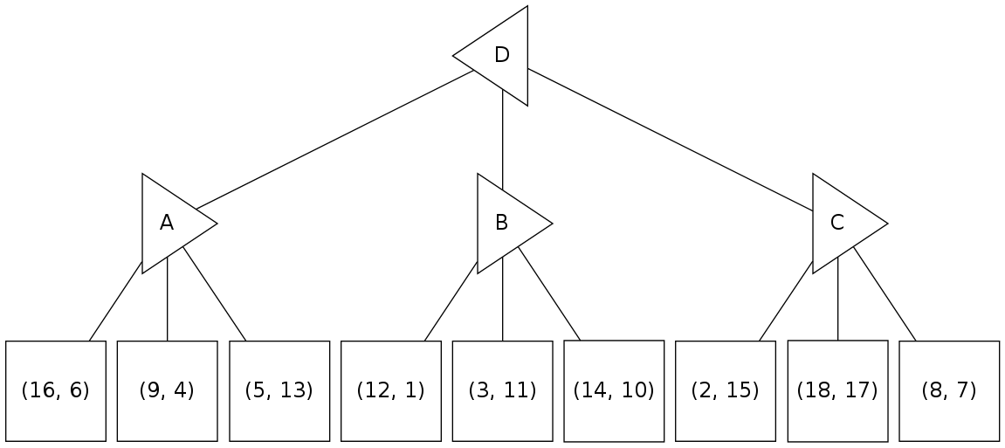
Ex5: non-zero sum games
The sum of the two players' utilities are not necessarily zero (or constant). The leaf utilities are now written as pairs (U_{A},U_{B}). In this generalized setting, A seeks to maximize U_{A}, the first component, while B seeks to maximize U_{B}, the second component.
Note that left-pointing triangles (such as the root of the tree) correspond to player A, who maximizes the first component of the utility pair, whereas right-pointing triangles (nodes on the second layer) correspond to player B, who maximizes the second component of the utility pair. Propagate the terminal utility pairs up the tree using the appropriate generalization of the minimax algorithm on this game tree.
Player A
Player B
Notes:
A; 5,13
B; 3, 11
C; 18, 17
D; 18, 17

Slide 45
Ex 6: non zero sum games
Assume that your generalization of the minimax algorithm calculates a value (U_{A},U_{B}) for the root of the tree. Which of the following statements are true?
Assuming A and B both play optimally, player A's outcome is guaranteed to be exactly U_{A}.
Assuming A and B both play optimally, player B's outcome is guaranteed to be exactly U_{B}.
Assuming B plays sub-optimally (but A plays optimally), A's outcome is guaranteed to be at least U_{A}.
Notes:
1 and 2 are correct

Slide 46
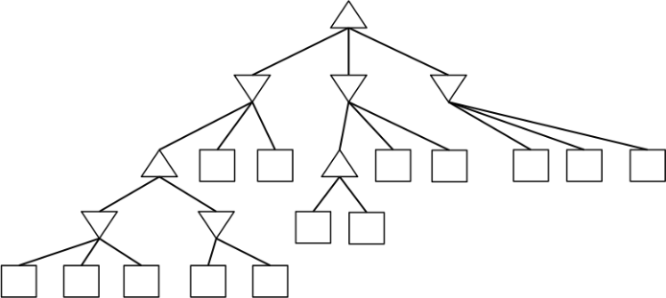
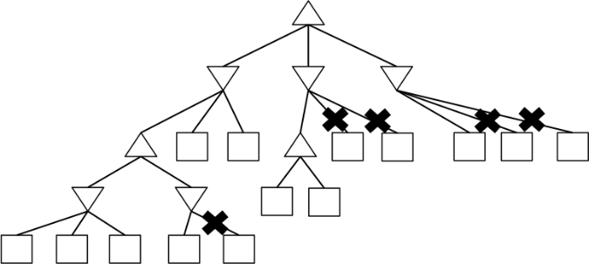
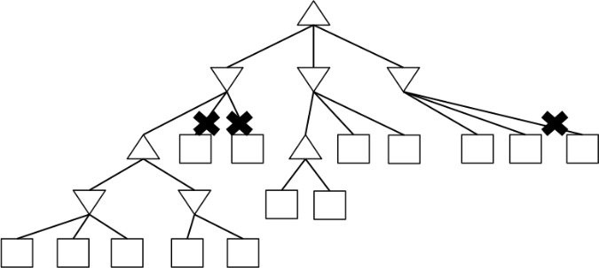
Ex 7
Assume we run α - β pruning, expanding successors from left to right.
For each figure, determine if there is there an assignment of utilities to the terminal nodes such that the pruning shown in the figure will be achieved.
Notes:
The first two are ok

Slide 47
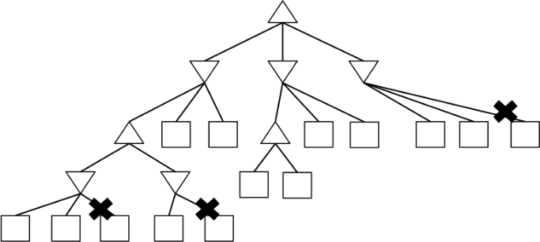
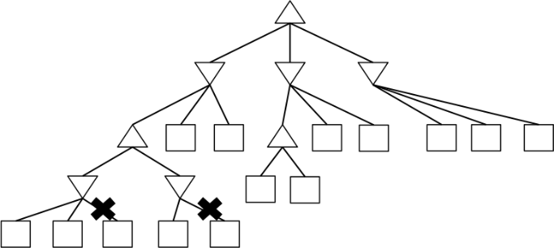
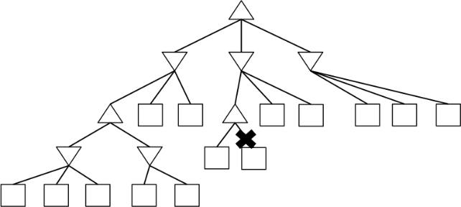
Ex 7 – continue
Assume we run α - β pruning, expanding successors from left to right.
For each figure, determine if there is an assignment of utilities to the terminal nodes such that the pruning shown in the figure will be achieved.
Notes:
None

Slide 48
Ex 7 – hint
Perhaps the simplest check is as follows: pruning of children of a minimizer node m is possible (for some assignment to the terminal nodes), when both of the following conditions are met: (i) the value of another child of m has already been determined, (ii) somewhere on the path from m to the root node, there is a maximizer node M for which an alternative option has already been explored.
The pruning will then happen if any such alternative option for the maximizer had a higher value than the value of the "another child" of m for which the value was already determined.

Slide 49
Ex 8: sub-optimal strategies
Player MAX and player MIN are playing a zero-sum game with a finite number of possible moves. MAX calculates the minimax value of the root to be M. You may assume that at every turn, each player has at least 2 possible actions. You may also assume that a different sequence of moves will always lead to a different score (i.e., no two terminal nodes have the same score). Which of the following statements are true?
Assume MIN is playing sub-optimally at every turn, but MAX does not know this. The outcome of the game could be larger than M (i.e. better for MAX).
Assume MIN is playing sub-optimally at every turn, and MAX knows exactly how MIN will play. There exists a policy for MAX to guarantee a better outcome than M.
Assume MIN is playing sub-optimally at every turn. If MAX plays according to the minimax strategy, the outcome of the game could be less than M.
Notes:
1 is true
2 is true

Slide 50
Ex 8 – continue
Assume that MIN is playing randomly (with a uniform distribution) at every turn, and MAX knows this.
There exists a policy for MAX such that MAX can guarantee a better outcome than M.
There exists a policy for MAX such that MAX's expected outcome is better than M.
To maximize his or her expected outcome, MAX should play according to the minimax strategy (i.e. the strategy that assumes MIN is playing optimally).
Notes:
2 is true
3 is wrong because max has to maximize its expected utility (expectimax strategy)
1 is wrong because there is no guarantee that random play from min will not hit the optimal strategy for at least once

Slide 51
Ex 9
In this question, we will investigate shallow search, also known as depth-limited search. Depth-limited search is not guaranteed to find the optimal solution to the original problem. The point of this question is to explore some of the (potentially undesirable) behavior of depth-limited search, and to illustrate that the quality of the evaluation function can play a big role in how well depth-limited search performs.
Consider the following Pacman configuration, in the board below. At each time step, Pacman can move either West (left) or East (right) and is using limited-depth minimax search (where the minimizing agent does not really do anything) to choose his next move. Pacman is 3 East moves away from the food, and chooses from the following state evaluation functions:
F1(state) = -Number of food pellets left
F2(state) = -Number of food pellets left + 0.5/(distance to closest food pellet + 1); distance to closest food pellet is taken as 0 when no food remains.

Slide 52
Ex 9 – continue
The search depth referred to in this question corresponds to the depth in a search tree that only considers the maximizer's actions. For example, if the search considers sequences of up to 2 actions by the maximizer, it'd have a search depth of 2.
In the questions below, optimality means that the action is an optimal first action according to the search tree with the specified depth and the specified evaluation function. In each of these questions, there are 5 different search trees under consideration: one of depth 1, one of depth 2, ... , and one of depth 5.
Note that there can be more than one optimal action for a given search tree (this can happen whenever there are ties). Also, note that a search does not finish when the dots are eaten.

Slide 53
Ex 9 – continue
Using F1 as the state evaluation function, for what search depths will East be an optimal first action? (answer for depths from 1 to 5)
Using F1 as the state evaluation function, for what search depths will West be an optimal first action? (answer for depths from 1 to 5)
Using F2 as the state evaluation function, for what search depths will East be an optimal first action? (answer for depths from 1 to 5)
Using F2 as the state evaluation function, for what search depths will West be an optimal first action? (answer for depths from 1 to 5)
F1(state) = -Number of food pellets left
F2(state) = -Number of food pellets left + 0.5/(distance to closest food pellet + 1); distance to closest food pellet is taken as 0 when no food remains.
Notes:
1,2, 3, 4, 5
1, 2 ,5
1, 2 , 3, 4, 5
5

Slide 54
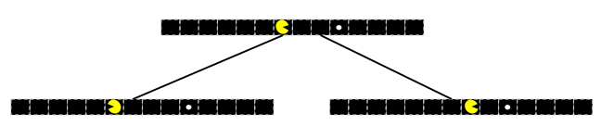
Ex 9 – hint
Consider the search tree of depth 1 shown below. What is the value of East and what is the value of West for this tree when using F1? How about when using F2?

Slide 55
Utility exercises

Slide 56
Ex 10
Consider a lottery L = [0.2,A ; 0.3,B ; 0.4,C ; 0.1,D ], where the utility values of each of the outcomes are U(A)=1, U(B)=3, U(C)=5, U(D)=2. What is the utility of this lottery, U(L)?
Notes:
0.2*1+0.3*3+0.4*5+0.1*2 = 3.3

Slide 57
Ex 10 – continue
Consider a lottery L1 = [0.5,A;0.5,L2], where U(A)=4, and L2 = [0.5,X;0.5,Y] is a lottery, and U(X)=4, U(Y)=8. What is the utility of the first lottery, U(L1)?
Notes:
0.5*4+0.5*(0.5*4+0.5*8) = 5

Slide 58
Ex 10 – cnt.
Assume A≻B, B≻L, where L = [0.5,C;0.5,D], and D≻A. Assuming rational preferences, which of the following statements are guaranteed to be true?
A≻L
A≻C
A≻D
B≻C
B≻D
Notes:
A≻L, transitivity
U(A)> 0.5 U(C) + 0.5 U(D) and U(D) > U(A) => 0.5 U(D) > 0.5 U(A) => 0.5 U(A) > 0.5 U(C) => A≻C
A≻D No!
U(B) > 0.5U(C) + 0.5 U(D) but U(D) > U(A) > U(B) => U(B) > U(C)
U(B) > U(D) No!

Slide 59
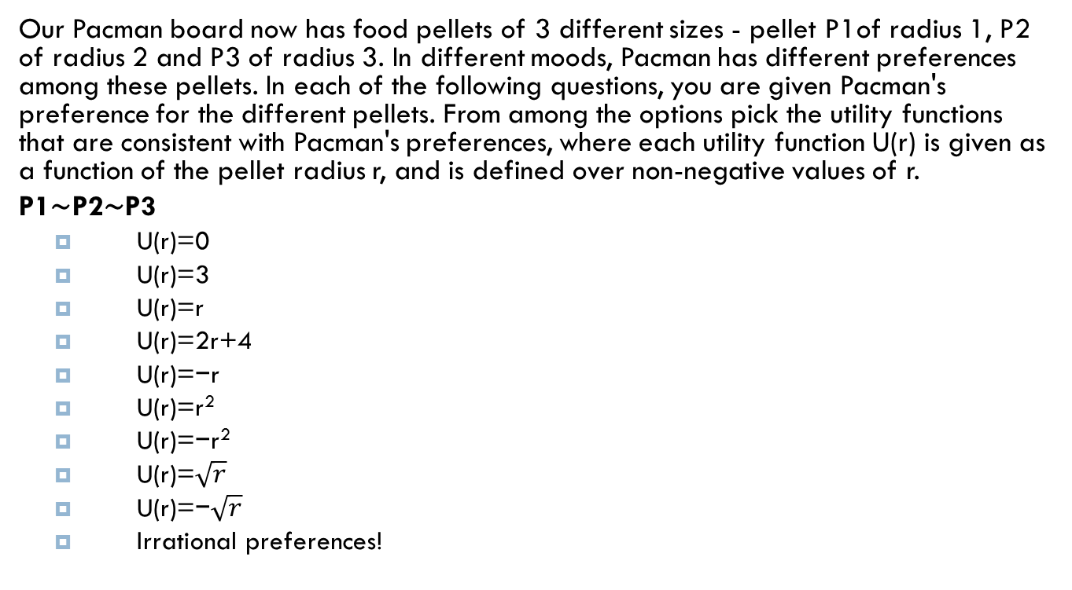
Ex 11
Our Pacman board now has food pellets of 3 different sizes - pellet P1of radius 1, P2 of radius 2 and P3 of radius 3. In different moods, Pacman has different preferences among these pellets. In each of the following questions, you are given Pacman's preference for the different pellets. From among the options pick the utility functions that are consistent with Pacman's preferences, where each utility function U(r) is given as a function of the pellet radius r, and is defined over non-negative values of r.
P1∼P2∼P3
U(r)=0
U(r)=3
U(r)=r
U(r)=2r+4
U(r)=−r
U(r)=r²
U(r)=−r²
U(r)=$\sqrt{r}$
U(r)=−$\sqrt{r}$
Irrational preferences!
Notes:
U(r)=0 , U(r)=3

Slide 60

Ex 11
Our Pacman board now has food pellets of 3 different sizes - pellet P1of radius 1, P2 of radius 2 and P3 of radius 3. In different moods, Pacman has different preferences among these pellets. In each of the following questions, you are given Pacman's preference for the different pellets. From among the options pick the utility functions that are consistent with Pacman's preferences, where each utility function U(r) is given as a function of the pellet radius r, and is defined over non-negative values of r.
P1≺P2≺P3
U(r)=0
U(r)=3
U(r)=r
U(r)=2r+4
U(r)=−r
U(r)=r²
U(r)=−r²
U(r)=$\sqrt{r}$
U(r)=−$\sqrt{r}$
Irrational preferences!
Notes:
U(r)=r , U(r)=r² , U(r)=$\sqrt{r}$, U(r)=2r+4

Slide 61

Ex 11
Our Pacman board now has food pellets of 3 different sizes - pellet P1of radius 1, P2 of radius 2 and P3 of radius 3. In different moods, Pacman has different preferences among these pellets. In each of the following questions, you are given Pacman's preference for the different pellets. From among the options pick the utility functions that are consistent with Pacman's preferences, where each utility function U(r) is given as a function of the pellet radius r, and is defined over non-negative values of r.
P1≻P2≻P3
U(r)=0
U(r)=3
U(r)=r
U(r)=2r+4
U(r)=−r
U(r)=r²
U(r)=−r²
U(r)=$\sqrt{r}$
U(r)=−$\sqrt{r}$
Irrational preferences!
Notes:
U(r)=−r , U(r)=−r² , U(r)=−$\sqrt{r}$

Slide 62

Ex 11 – continue
(P1≺P2≺P3) and (P2≺( 50-50 lottery among P1 and P3))
U(r)=0
U(r)=3
U(r)=r
U(r)=2r+4
U(r)=−r
U(r)=r²
U(r)=−r²
U(r)=$\sqrt{r}$
U(r)=−$\sqrt{r}$
Irrational preferences!
Notes:
U(r)=r²

Slide 63

Ex 11 – continue
(P1≻P2≻P3) and (P2≻( 50-50 lottery among P1 and P3))
U(r)=0
U(r)=3
U(r)=r
U(r)=2r+4
U(r)=−r
U(r)=r²
U(r)=−r²
U(r)=$\sqrt{r}$
U(r)=−$\sqrt{r}$
Irrational preferences!
Notes:
U(r)=−r²

Slide 64
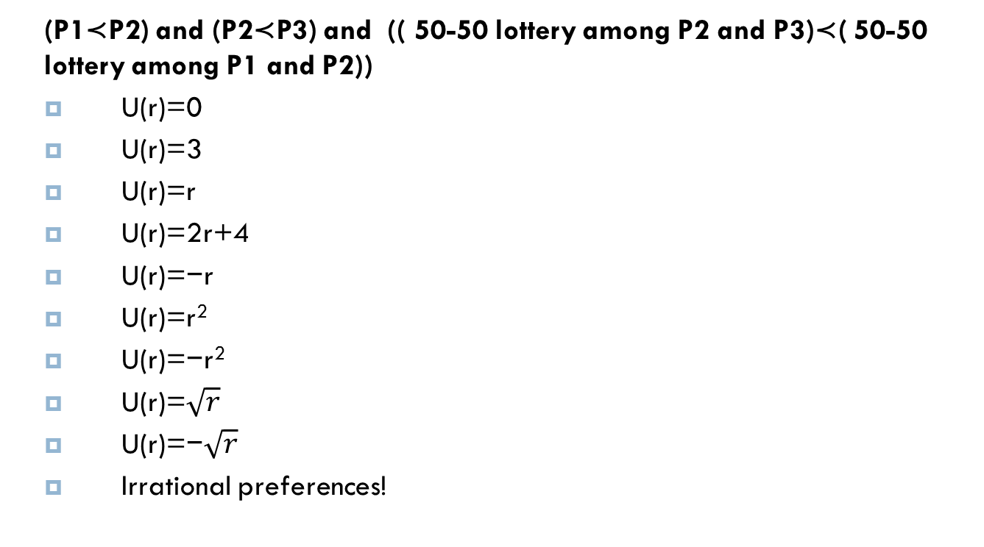
Ex 11 – continue
(P1≺P2) and (P2≺P3) and (( 50-50 lottery among P2 and P3)≺( 50-50 lottery among P1 and P2))
U(r)=0
U(r)=3
U(r)=r
U(r)=2r+4
U(r)=−r
U(r)=r²
U(r)=−r²
U(r)=$\sqrt{r}$
U(r)=−$\sqrt{r}$
Irrational preferences!
Notes:
Irrational preferences!

Slide 65
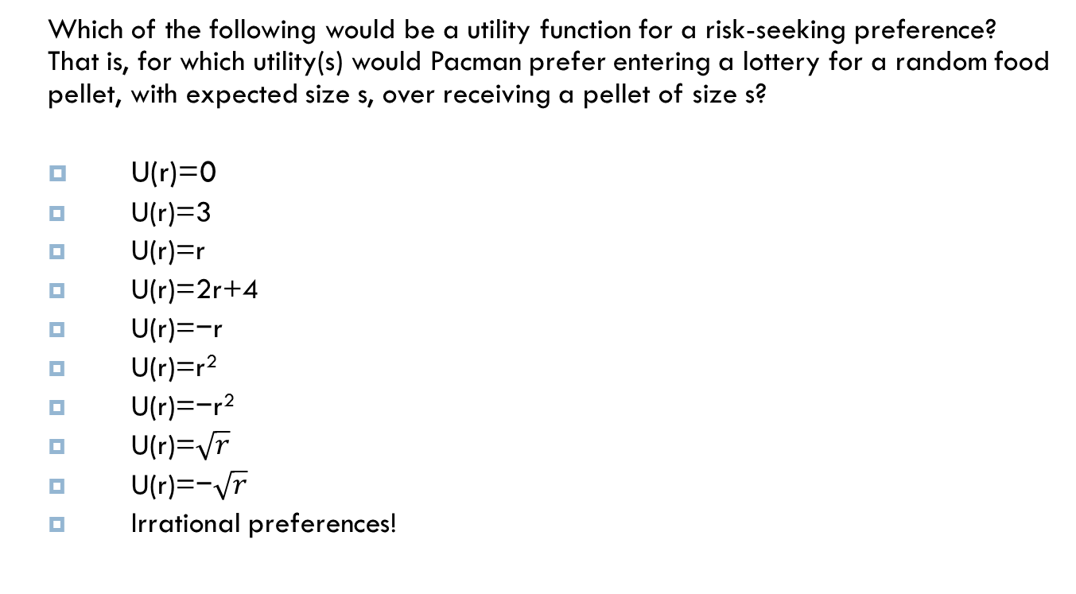
Ex 11 – continue
Which of the following would be a utility function for a risk-seeking preference? That is, for which utility(s) would Pacman prefer entering a lottery for a random food pellet, with expected size s, over receiving a pellet of size s?
U(r)=0
U(r)=3
U(r)=r
U(r)=2r+4
U(r)=−r
U(r)=r²
U(r)=−r²
U(r)=$\sqrt{r}$
U(r)=−$\sqrt{r}$
Irrational preferences!
Notes:
R², -$\sqrt{r}$

Slide 66
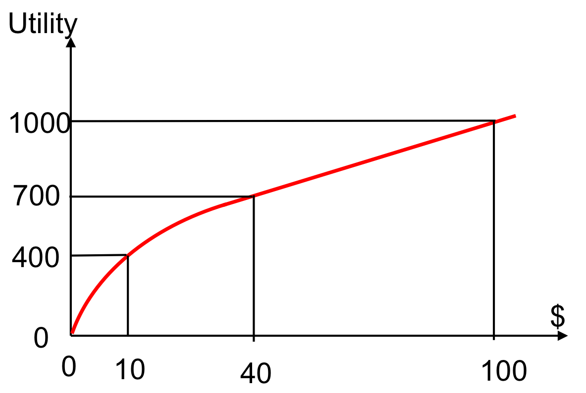
Ex 12
Consider the utility function shown below.
Under the above utility function, what is the certainty equivalent monetary value in dollars ($) of the lottery [0.6,$0;0.4,$100]?
I.e., what is X such that U($X) = U([0.6,$0;0.4,$100])?
Hint: Keep in mind that U([p,A;1−p,B]) is not equal to U(pA+(1−p)B).
Notes:
10

